Slide 1
Capstone project week2
Submitted by:
Zaid Hasib

Slide 2
Problem Statement:
In this project we will try to find the optimal location for a resturant . Specifically , this will be helpful for stakeholder who are going to open new Italian Resturant in the Kormangla area of Banglore, India
Since there are many resturants in the banglore , we will try to find the area where there are less crowd. And We will also prefer that it wil be close to the city center
We Will use ML algorithm to generate most promising neighbourhood.

Slide 3
Data Extraction:
For data , we will use geopy libraries and used the latitude from the libaray hen passing the address.
I used folium , libarary to plt the map from the co-ordibates extracted from geopy .

Slide 4
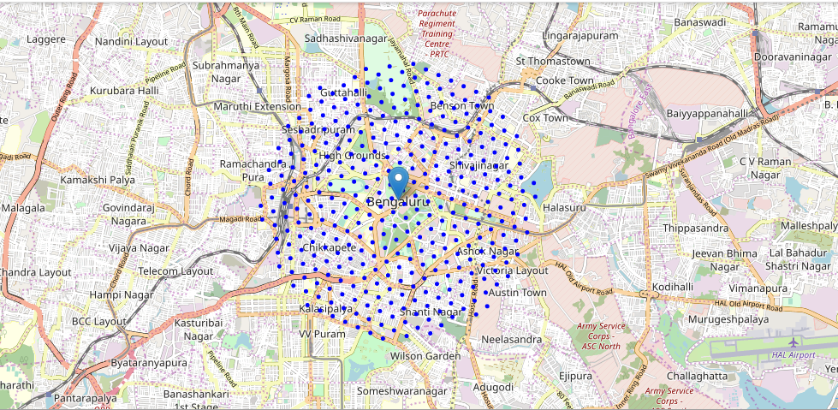
With the use of folium e have created the map of Banglore and point the area into segments. Total area coverage 12x12 . The radius of then segments is 600 m

Slide 5
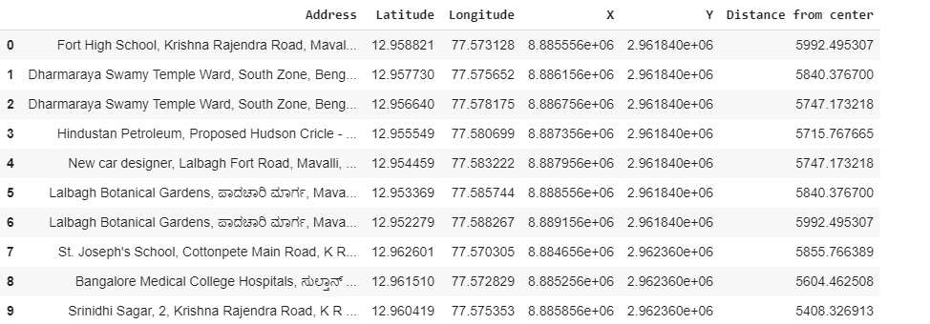
Data extraction from the geopy and putting the segment . Here we will find the co-ordinate of the area of the segments.

Slide 6
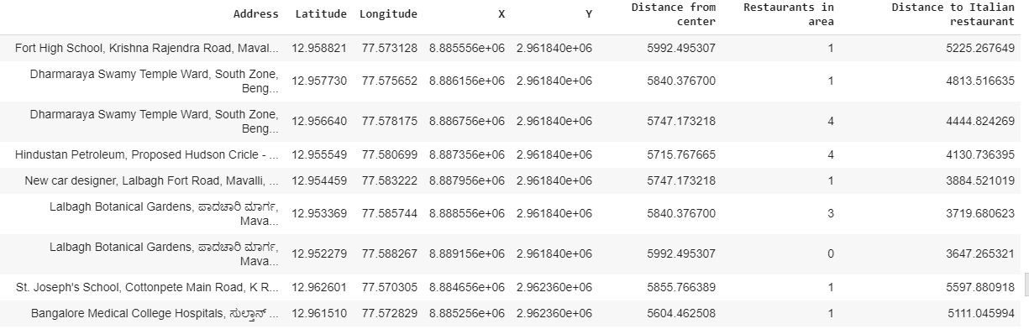
Using four square api, we will find the list of Italian restaurants , we will find the Italian restaurants in the area and appending it into new data frame. Here we will find the distance of the nearby italian resturants.

Slide 7
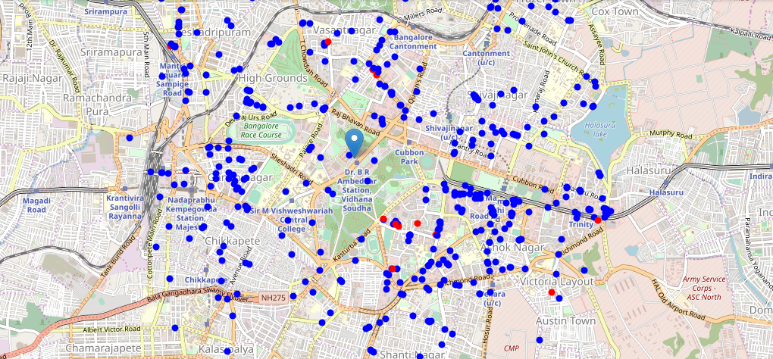
Plot the restaurants in blue and among them red point for the Italian restaurant

Slide 8
By the map and the data , we will apply k-means and found the list of segments(area) in Bangalore where opening Italian Restaurant would be beneficial
Thank You!

